Slide 1
Larsen and Toubro Infotech
Notes:
Greetings
Springboot App ,we developed as a part of java micro services training

Slide 2
The Ask – Where we started
…..
Notes:
In group we a begineer level of java ,
but no exp in ( tools used)(

Slide 3
Framework for 3 Weeks
3 weeks plan
Everyday Discussion about topics / Technologies/ doubt clearance .
Every day with SME/Trainer discussion of Project progress & transformation based on backend Technologies

Slide 4
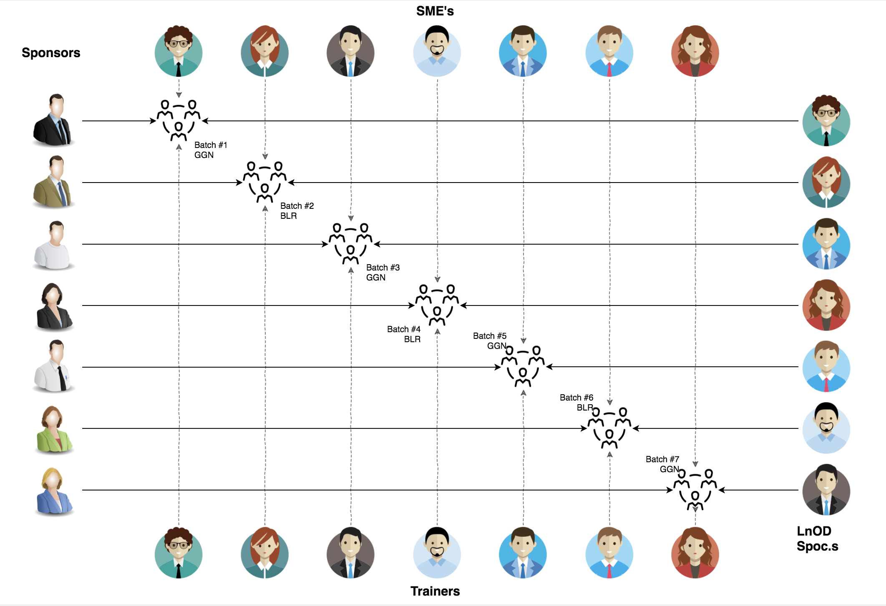
Stakeholders
Sponsors
LTI
2. SME’s
Amit Balyan

Slide 5
Our next starts
NOW
Notes:
Time – 1 min
Swati

Slide 6
3 WEEKS OF TRAINING + PROJECT DEMO
15 DAYS
360 HOURS
21600 MINUTES
129600 SECONDS
LIMITLESS KNOWLEDGE

Slide 7

Agenda
01
Our Journey
02
Our Team
03
Team Structure
04
Project Goals
05
Engineering Practices
06
Tech Stack
07
Development
08
Challenges & Learnings
09
Demo
10
Questions
11
Notes:
Time – 1 min

Slide 8

Our Journey
Notes:
Time - 2 mins

Slide 9
CRS
Mindset
Process
5
CRS Project
Tools
4
Adapting to a developer
Mindset
Comprehend
3
Design Thinking
2
Decide the Technologies JAVA/REST
1
Understanding Project Goals
Notes:
1- understand problem and needs , identifying the tools aligning with our project goals
2-Mysql, github, postman , sts, springboot app
3.Design the application and making is more efficient every step of the way by overcoming different problems faced during the development and collaboration

Slide 10

Our Team
Neelam
Nagarjun Nimmalwar
Nathan Anthony
Chinmay Gupta
Notes:
Time – 2 mins

Slide 11


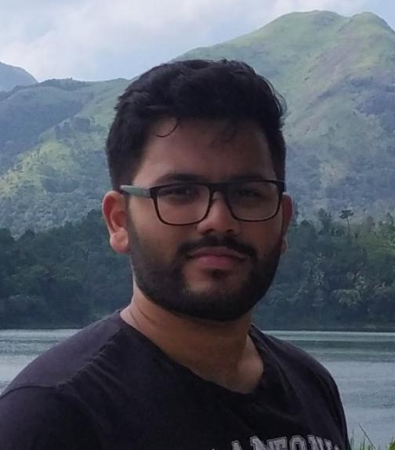
Neelam
Nagarjun Nimmalwar
Nathan Anthony
And Chinmay Gupta

Slide 12

Team Structure
Notes:
Collabrate , plan, distribute, debug together and help eachother out

Slide 13

Project Goals
Notes:
Time – 3 mins

Slide 14




Our Vision
To create an course Management System using full stack development tools and technologies, where an agent as well as an customer scan place order from various products.
1
2
Quality
Security
3
4
Interactivity
Speed
Notes:
User satisfaction and brand value

Slide 15

Engineering Practices
Notes:
Time – 5 mins

Slide 16
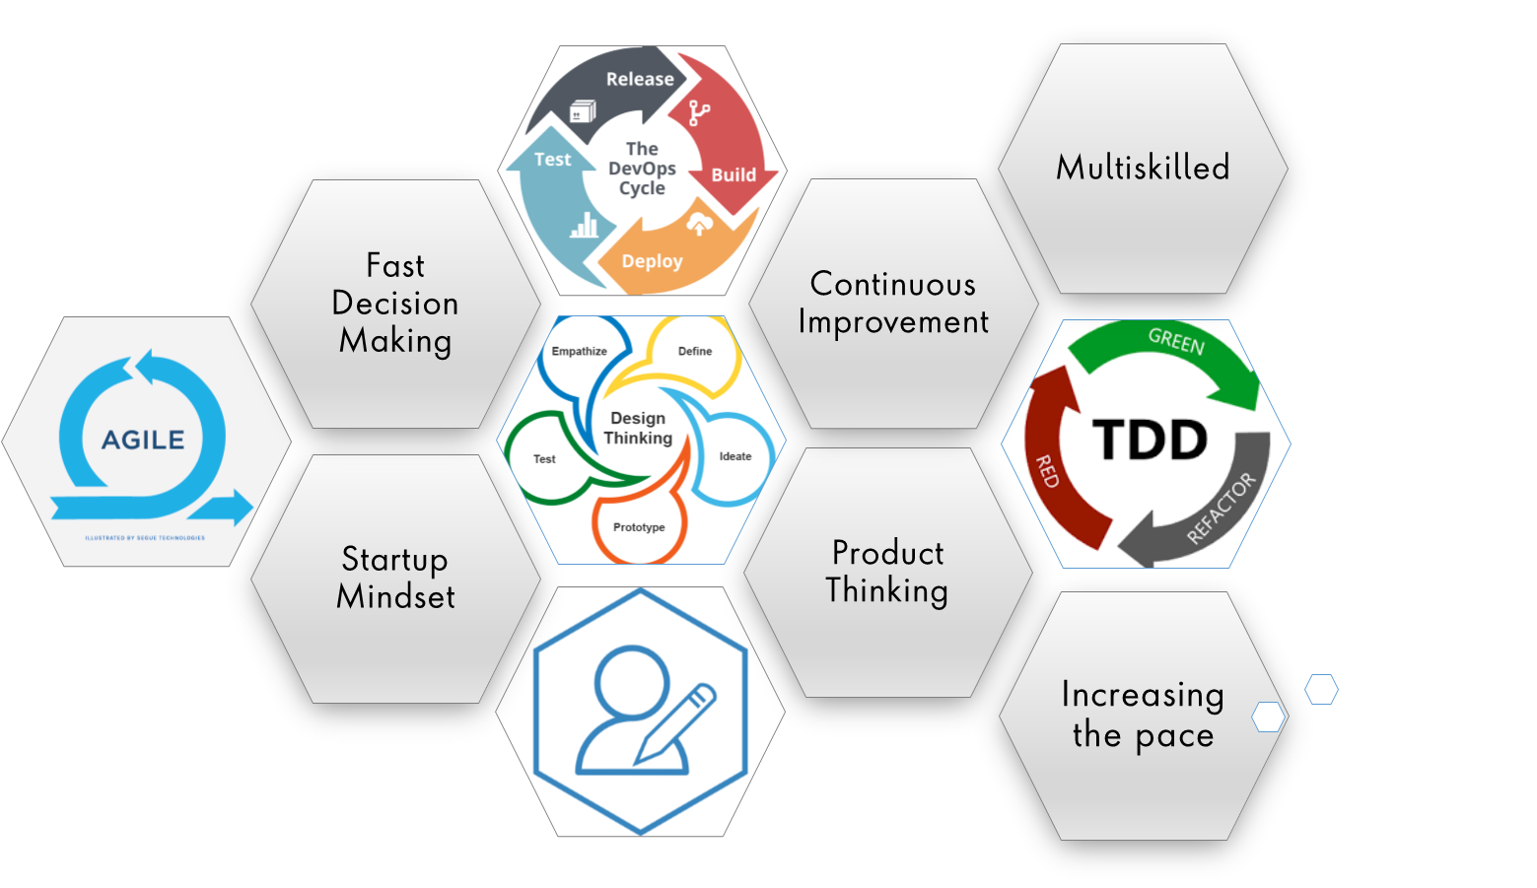
Notes:
Product Thinking (Design Thinking, Requirement Analysis, )
Multi Skilled (Frontend, Backend, DevOps)
Fast Decision Making (Agile)
Increasing the Pace (Automation CI/CD)
Startup Mindset (Agile)
Continuous Improvement (Retros)

Slide 17
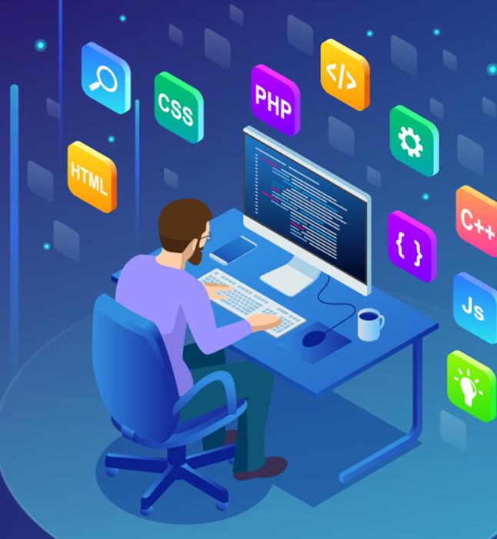
Tech Stack
Notes:
Time – 2 mins

Slide 18







Backend
Data
Tools
Core Language
SQL Database
Tools used
Framework
Notes:
Time – 1 min

Slide 19

Development
Notes:
Time – 1 min

Slide 20
Discussing the requirements and functionalities
Distributing the tasks
Requirement understanding
Research and analysis
Estimation
Sprint Planning
Spring Grooming
Delivery
Sprint Implementation
LLD
Development
Code Review
Commit
Integrate
Deploy
Test
Notes:
Time – 1 min

Slide 21

Challenges & Learnings
Notes:
Time – 2 mins

Slide 22

Demo
Notes:
Time –
Architecture – 5 mins
NFR Dashboard – 3 mins
Demo – 10 mins
1. Show the Responsiveness and Wave tool first

Slide 23

Questions
Notes:
Time - ?

Slide 24
Thank you
Notes:
Time – After this show the testimonial video. 1 min

